Slide 1
1.5.3 Walkthrough #3 canvas_circle_art.py canvas_rectangle_art.py canvas_shape_art.py canvas_recolor_art.py
Computer Science and Software Engineering
© 2014 Project Lead The Way, Inc.

Slide 2
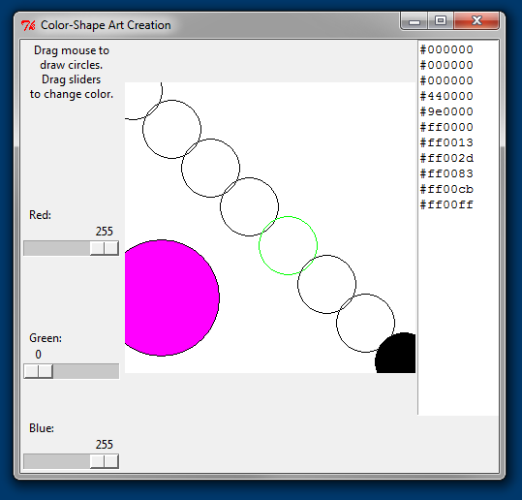
Demo: canvas_circle_art.py
Notes:
Run the canvas_circle_art program yourself. Drag on the canvas and then slide the sliders.

Slide 3
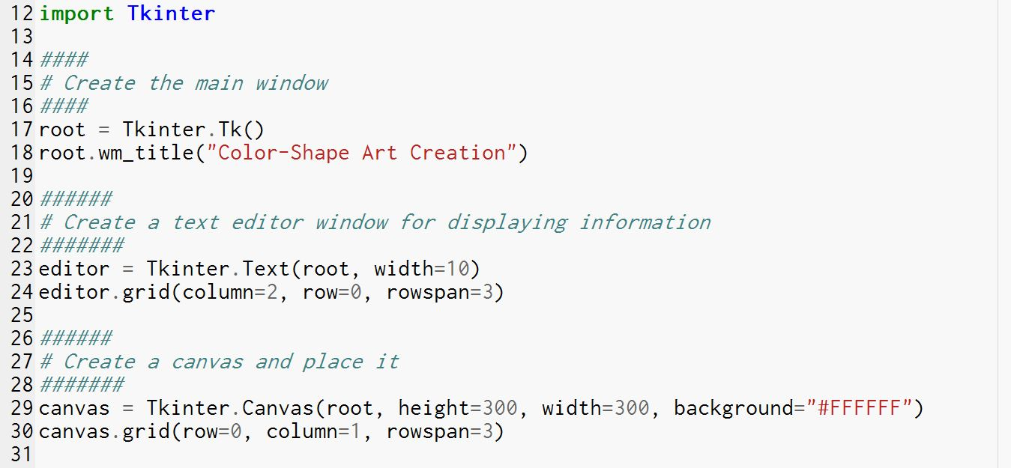
Initialization, View
Notes:
Creates a Text and a Canvas. We’ll come back to the Canvas in a few slides.

Slide 4
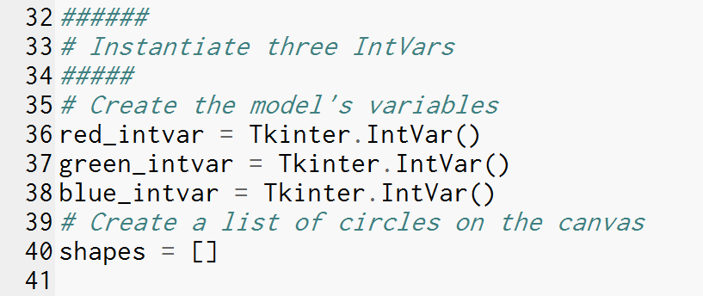
Model
Notes:
Each of the three Scales will need an IntVar.
Line 40 initializes a variable to an empty list. What variable does it seem like this is going to fulfil?
Yes! It’s initializing an aggregator. Later, a handler will add canvas items to the list of shapes.

Slide 5
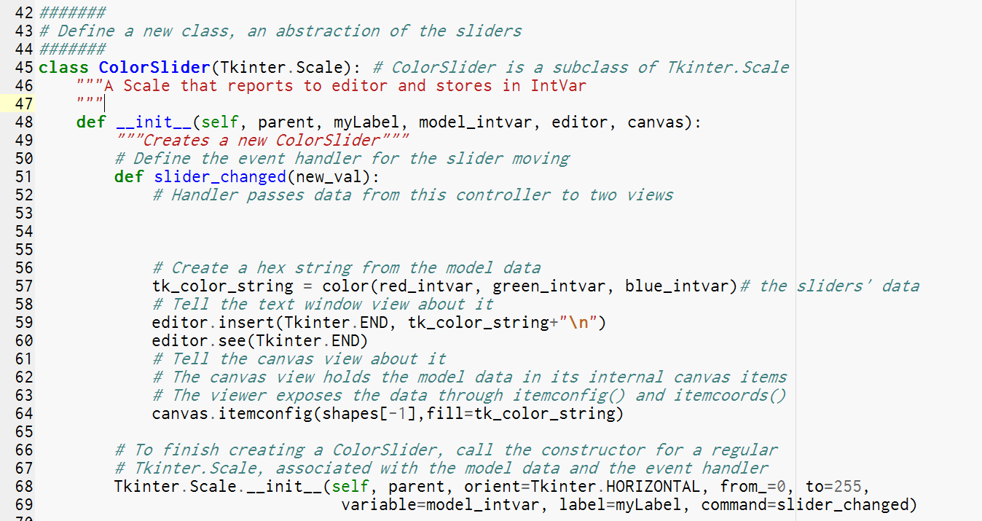
Controller – Part I: New Subclass of Scale
Notes:
Warning: we intentionally go through the ceiling here. This slide is unlikely to make sense to many beginners. Don’t worry about it. Read it anyway. You might pick up a term or two.
This example demonstrates creating a class. We could create the three sliders one at a time, repeating the code required to create each one. Then we wouldn't need to create a class. You won’t need to change anything in these lines of code, though, so it seemed safe to show you things you won’t be ready to try yourself. We used this as an opportunity to show you more advanced object-oriented techniques.
Here we define a new class of objects called ColorSlider objects.
Line 45 says that this new class is a subclass of Tkinter.Scale. Tkinter.Scale is a *superclass*, a parent from which ColorSlider can *inherit* attributes and methods. The classes can form a tree, except that classes can inherit from more than one superclass, so it’s not always a tree.
The class has only one function: the constructor, __init__(). The constructor takes five arguments; the interpreter will throw “self” in there for you when you construct an object.
That constructor has two parts:
1. First, it defines an event handler. Line 57 uses a function that is defined later in the program to build a string from the three IntVars. Lines 59 and 60 display the string in the Text widget. Line 64 changes the fill color of one of the canvas shapes: the most recent one, indexed by -1 in our aggregator.
2. Second, the constructor calls the superclass’ constructor, passing the object being created.

Slide 6
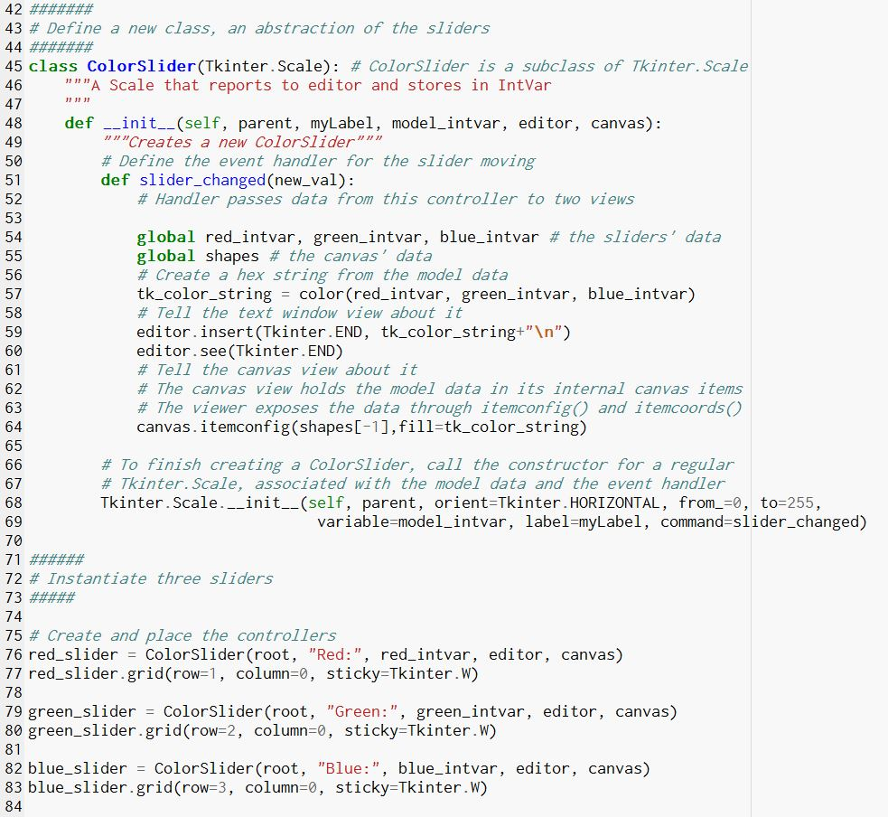
Controller – Part II: Three Scales
Notes:
We finish creating the model by instantiating three of these ColorSliders.

Slide 7
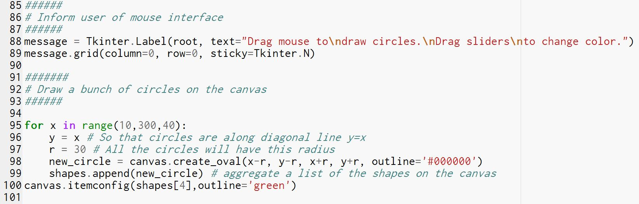
View – Part II
Notes:
Continuing the view from earlier in the code, we create a Label with instructions.
Then we decorate the canvas with circles numbered by 10,50,90,…,290. As we iterate through that list, each time we create a circle and aggregate its item number from the canvas.
Just for kicks, line 100 changes the outline color of the fifth circle.

Slide 8
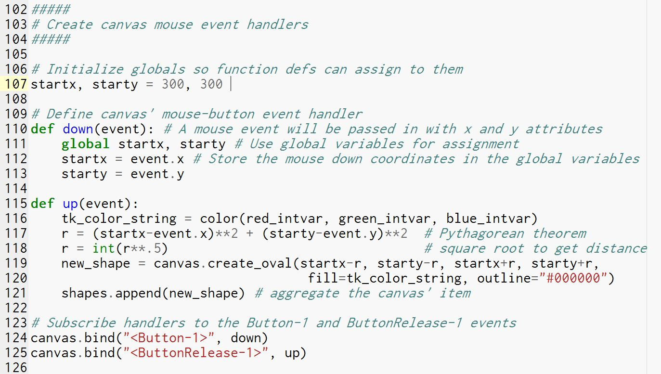
Controller – Part III: On the Canvas
Notes:
The Canvas is a view, showing circles we have created. And yet it also has controller roles to fulfill, handling mouse dragging events. These events are not a standard widget event for a Canvas, so we have to call the bind() method on the widget.
We define two handlers and then bind them to the events on the widget.
Bind will pass an event object to the handler. The object has attributes about where the mouse click occurred. On lines 112-113, we assign the mouse down coordinates to global variables so we can use them in the other function when the mouse is released.
Lines 117-118 uses those global variables to figure out the pixel distance of the mouse drag. Distance^2 = (change in x)^2 + (change in y)^2.
Line 121 aggregates the new shape. When a method is called on an object, Python will look for the object up the tree of nested scopes. No global declaration is needed.

Slide 9
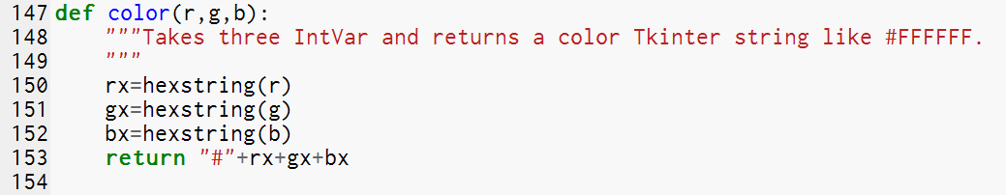
A Function to Help
Notes:
This function uses the hexstring() function described n the previous walkthrough.

Slide 10
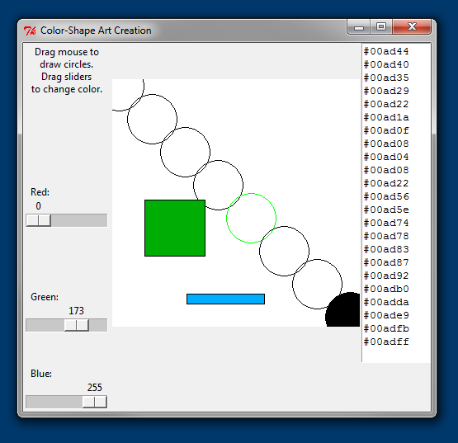
Demo: canvas_rectangle_art.py
Notes:
Your teacher will demonstrate the canvas_recolor_art.py program. Like canvas_circle_art, this program draws on the canvas with mouse drags. You will create this program.

Slide 11
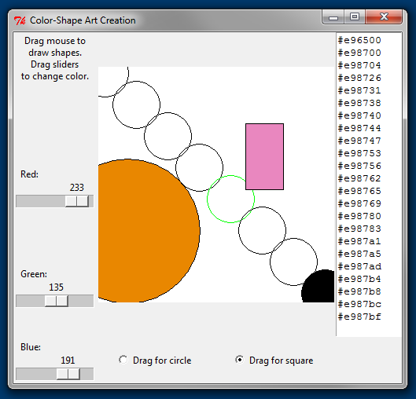

Demo: canvas_shape_art.py
Notes:
Your teacher will demonstrate the canvas_shape_art.py program. It is more advanced than the rectangle_art modification. Radiobuttons let the user choose between a circle or a rectangle (which is not necessarily a square).

Slide 12

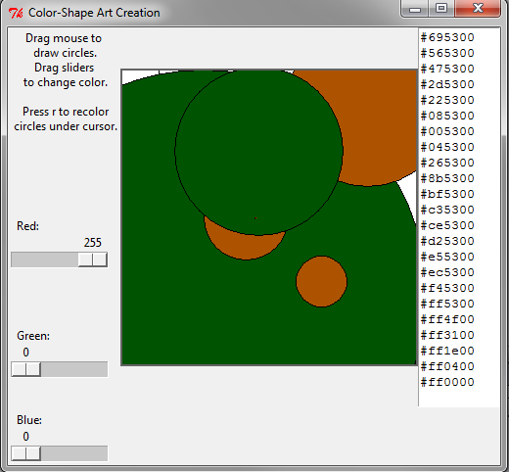
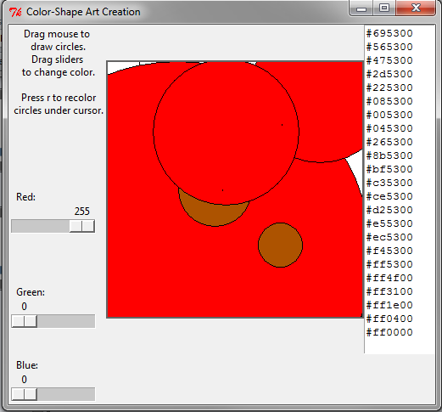
Demo: canvas_recolor_art.py
Clicking the mouse when the mouse cursor is at the tip of this arrow will set three circles to “red”
Notes:
Your teacher will demonstrate the canvas_recolor_art.py program. It is a much more advanced option for those who want a challenge.

